Slide 1




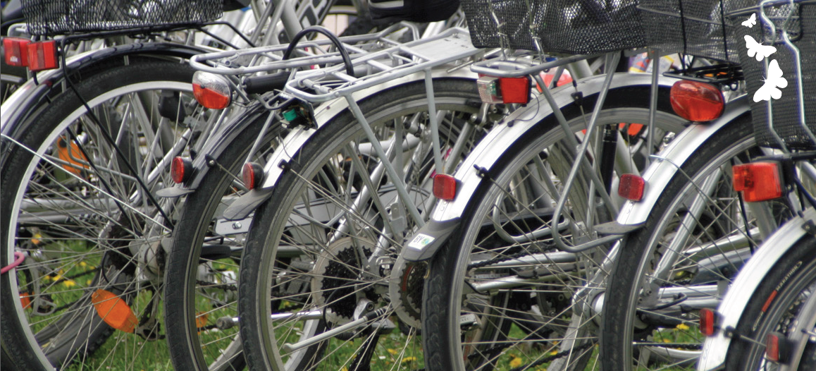




ICT cloud-based platform
and mobility services available,
universal and safe for all users
www.moveus-project.eu
General presentation

Slide 2

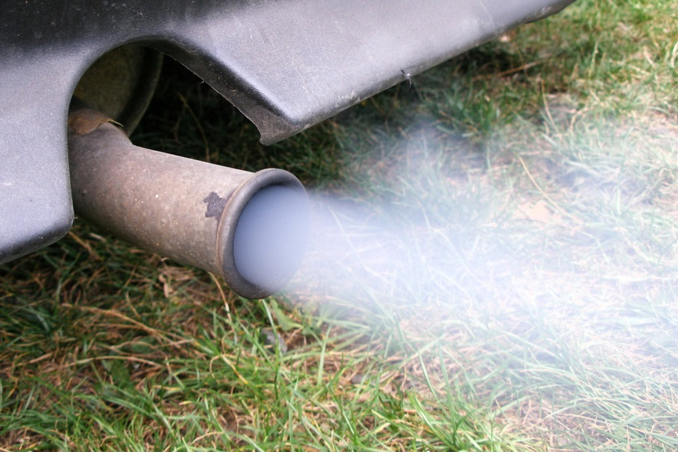
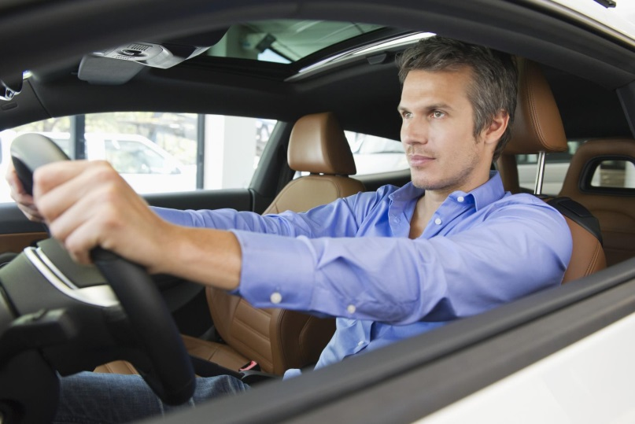
1) Rationale
70% of the energy in Europe is consumed in cities.
40% of petrol is used for finding somewhere to park
80% of urban trips involve just one person travelling alone

Slide 3
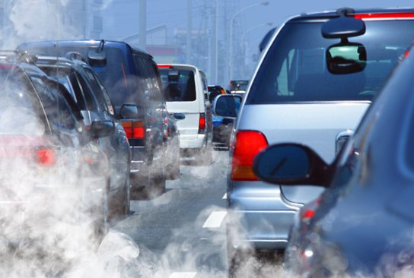
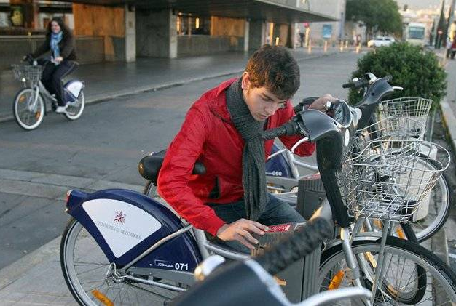

1) Rationale
Cities have a huge potential for energy saving by improving mobility services thought
  Smarter use of transport resources
  Intelligent technology

Slide 4







1) Rationale
ITS systems can help to reduce emissions and save energy thought a better demand management and providing the right information to people for taking more energy efficient decisions when choosing from different transportation modes

Slide 5

1) Rationale
ITS systems can help to reduce emissions and save energy thought a better demand management and providing the right information to people for taking more energy efficient decisions when choosing from different transportation modes

Slide 6




1) Rationale
ITS systems can help to reduce emissions and save energy thought a better demand management and providing the right information to people for taking more energy efficient decisions when choosing from different transportation modes

Slide 7

1) Rationale
ITS systems can help to reduce emissions and save energy thought a better demand management and providing the right information to people for taking more energy efficient decisions when choosing from different transportation modes

Slide 8
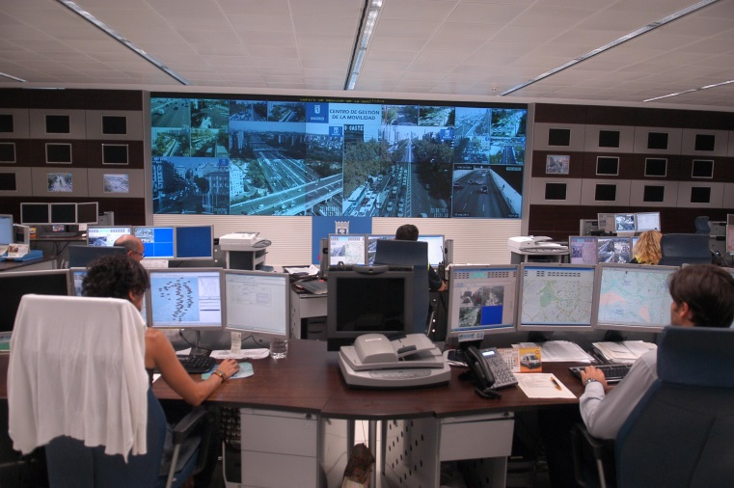
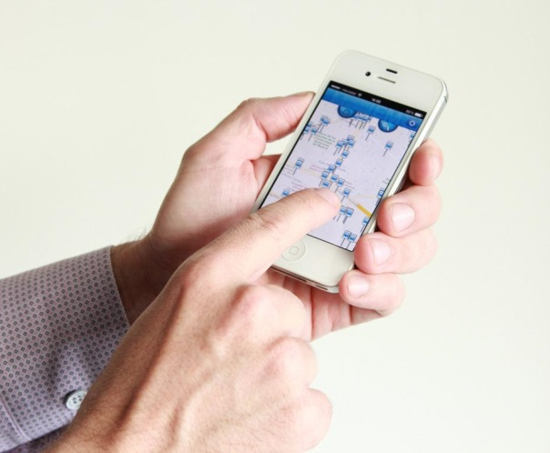
2) Goal
The main goal of Moveus Project is to design, implement, pilot, evaluate, disseminate and exploit a number of novel ICT tools for smart mobility in the context of smart cities, directly addressing real users’ needs while promoting a habit-change in their daily lives.

Slide 9



3) Objectives
    To integrate scattered and heterogeneous mobility data
    To provide green, multimodal, personalized, sustainable , safe and private, reliable and extensible services
    To elicit and structure real business cases

Slide 10

4) Users, providers and stakeholders
Citizens and Tourists
Public and private transit organizations and
transport/fleet operators
Cities authorities
Local business
Energy operators
ICT solutions providers
Non-profit organizations

Slide 11
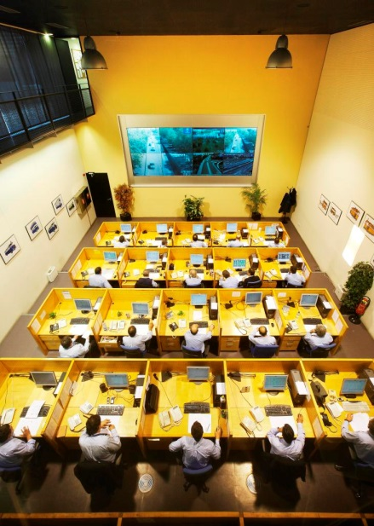

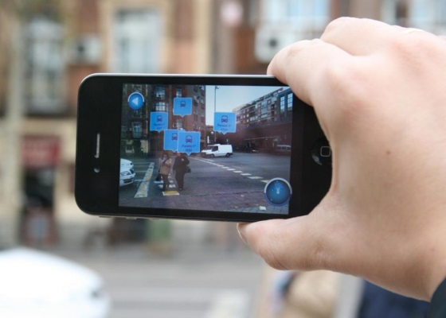
5) Expected results
From Project
A cloud-based mobility management platform
An API toolkit
Smart mobility applications for smartphones and control centers
Energy efficient assessment tools to measure users’ energy efficiency gains

Slide 12
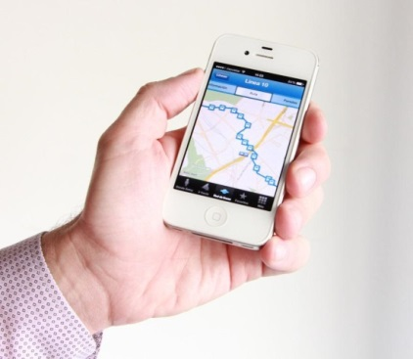

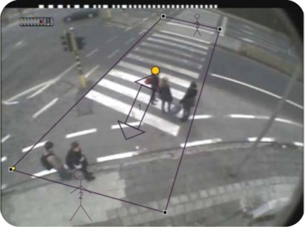


5) Expected results
For User
Travel recommendations to users
In-advance traffic information
Incident warning
Eco-routing and carbon footprint metering

Slide 13
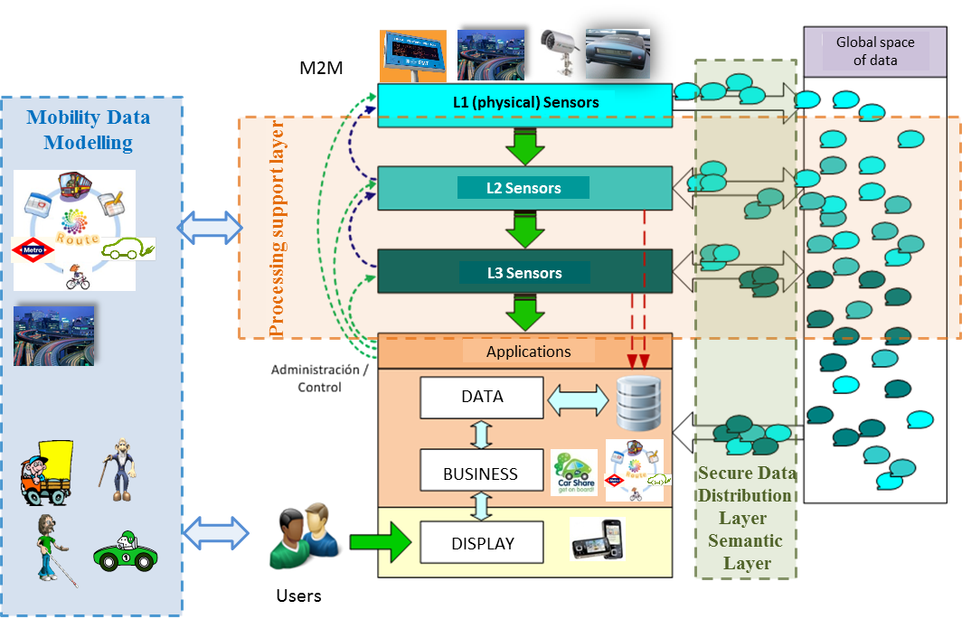
5) Architecture

Slide 14
5) Architecture

Slide 15
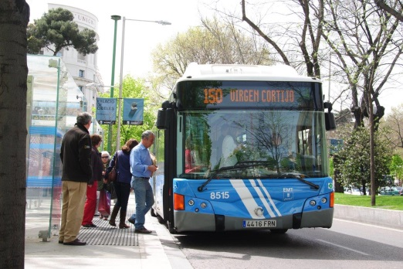
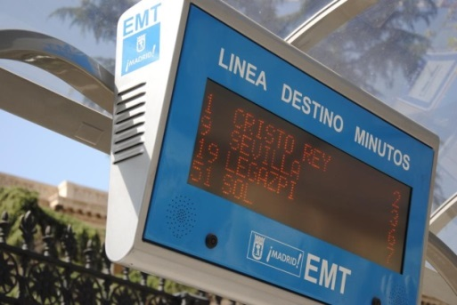
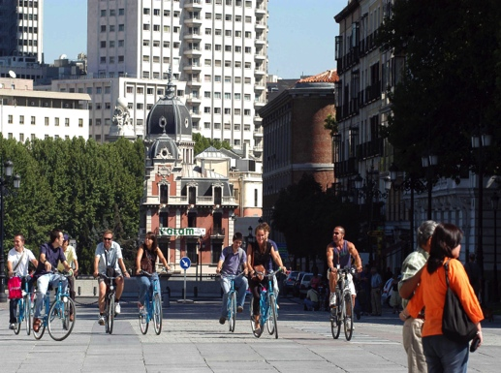
6) Pilots
Madrid
Contribute to implement the Innovation, Knowledge and Information Society in the city of Madrid
Provide mobility information in a handy way…
  - quick (real time),
  - personalized (different modes of transport)
  - at hand (on their personal devices).
… and facilitate the user to take most efficient mobility decision.

Slide 16
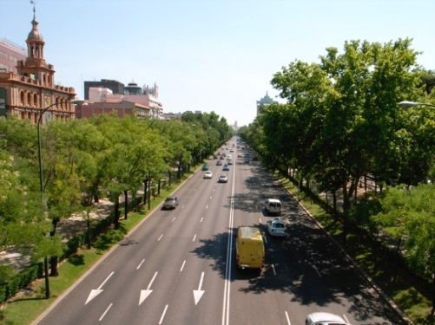
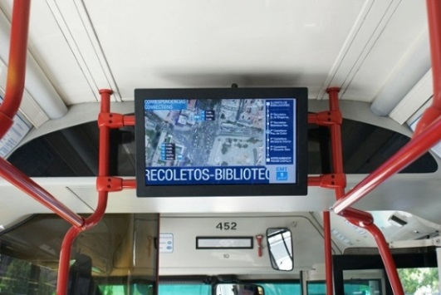
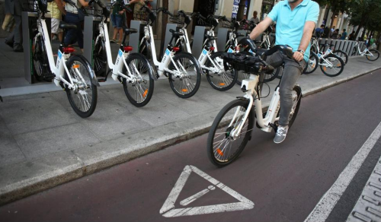
6) Pilots
Madrid
To foster the use of greener transport modes
  - public bus
  - public bike, bike-hiring
  - walking modes
To promote efficiency in the use of private cars.
To improve efficiency of the public bus system
To integrate the user –pedestrians, travelers, drivers, etc.- into the cooperative mobility architecture as a new source of information.

Slide 17
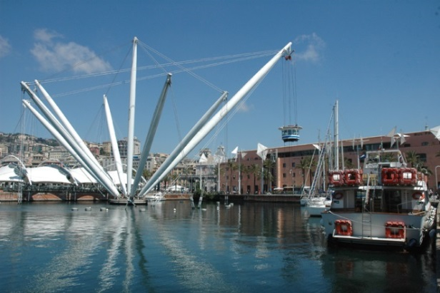
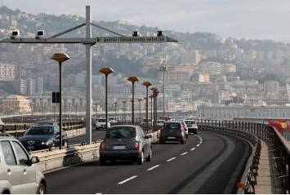
6) Pilots
Genoa
Contribute to:
  - The development of Genoa as a Smart City and the Mobility Urban Plan (PUM)
  - The strategic energy action plan with a foreseen reduction of 23% of CO2 emissions by 2020

Slide 18

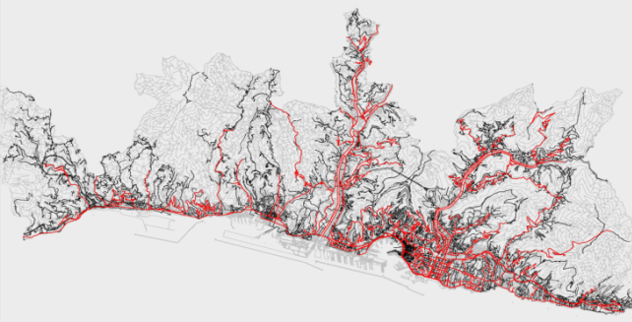
6) Pilots
Genoa
Establish an interactive process between the planning, development and testing of services in the field of smart mobility and energy efficiency.
Set up feedback mechanisms to identify the functionality, operation, usability of offered services.

Slide 19

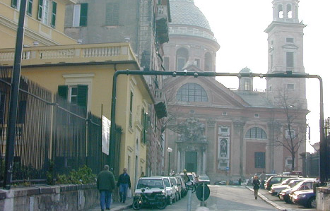
6) Pilots
Genoa
Multimodal journey planner with feedback from users
Integration of crowd sourced data into the Genoa traffic supervisor to share info in real-time and historical data
Fulfill personal mobility needs in an urban environment

Slide 20
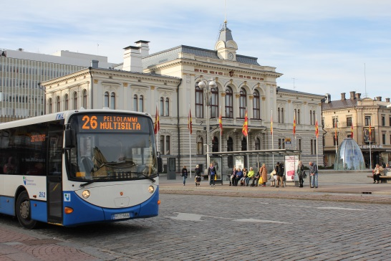
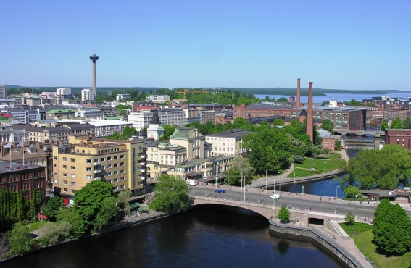
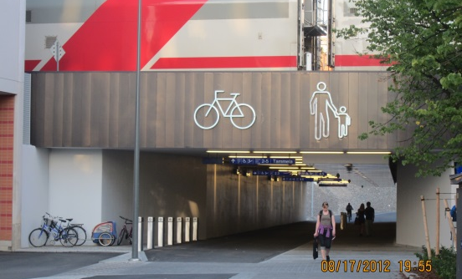
6) Pilots
Tampere
To increase the share of walking, cycling and public transport by developing for example cycling paths, public transport routes and bicycle parking spaces (Tampere City Strategy 2025).
The increase the share of sustainable mobility by opening traffic data, both real time and static in standard modes.

Slide 21
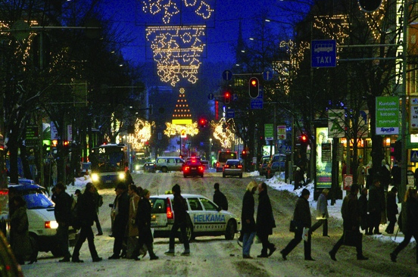
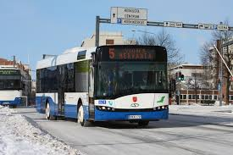


6) Pilots
Tampere
Provide mobility information in an integrated and easy-to-use way using mobile devices
The services will integrate cycling, public transport and car route information with real-time traffic and weather data
Provide energy and carbon footprint metering for the different transportation modes

Slide 22
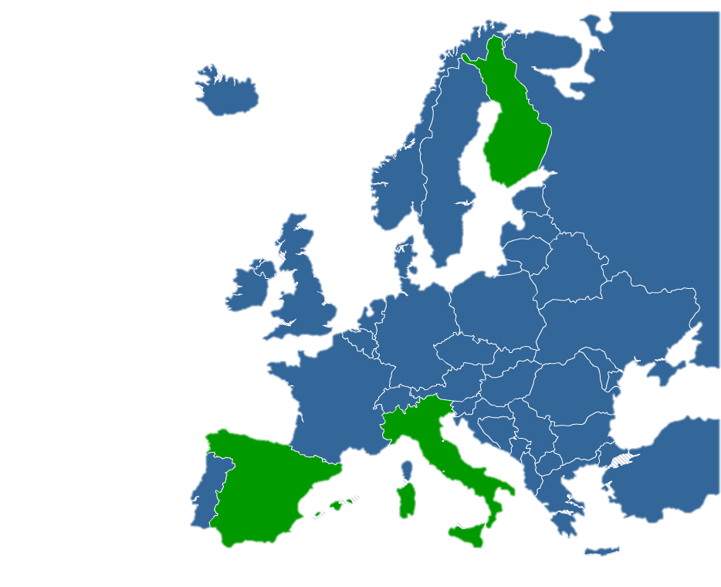








Consortium
Municipality
of Tampere
Municipality
of Genoa

Slide 23
Consortium
Public authorities
Research
Municipality
of Tampere
Municipality
of Genoa
Enterprise/Industry

Slide 24
GREEN, MULTIMODAL, PERSONALIZED, SUSTAINABLE, SAFE AND PRIVATE, RELIABLE AND EXTENSIBLE SERVICES

Slide 25

Partners
11
Municipality
of Genoa
Municipality
of Tampere
Coordinator’s Contact
Susana Palomares(ATOS) susana.palomares@atos.net
Begoña Molinete (TECNALIA) begona.molinete@tecnalia.com
This project has received funding from the European Union’s Seventh Framework Programme for research, technological development and demonstration under grant agreement no 608885.
www.moveus-project.eu

